Slide 1
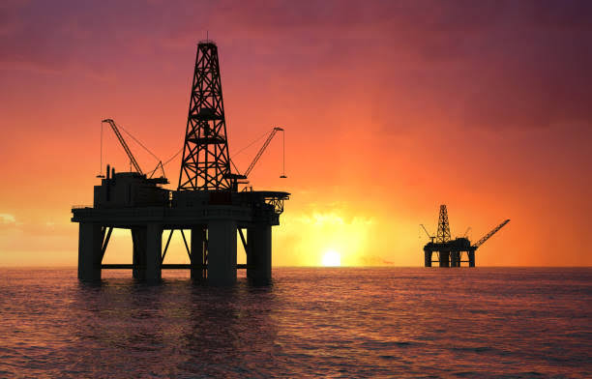
Predicting DRILLING RATE OF PENETRATION
Presented by:
Igemhokhai Shedrach
29th September, 2022

Slide 2





OUTLINE
Executive Summary
Introduction
Methodology
Results
Conclusion
Limitations and References

Slide 3
EXECUTIVE SUMMARY
With the recent developments, computing power, and availability of large data, the use of machine learning approach has spurred the interest of the oil and gas industry. Other works have been done to predict the Rate of Penetration(ROP) of Drilling using machine learning. This approach uses Support Vector Machine, Random Forest, Extreme Gradient Boost and deep neural networks to predict ROP using well depth, Pump pressure, Flow in velocity, and other Features. The data was gotten from GitHub and wrangled. A model with an accuracy and f1 score of 0.89.

Slide 4
INTRODUCTION
The Drilling rate of penetration (ROP) is a measure of the speed or the progress of the drill bit when it drills subsurface formation. ROP is usually reported in ft/h (field units) or m/h (SI units).
The Major portion of the well capital investment is consumed by drilling operations; hence, optimizing the ROP is a key aspect to reduce total well cost.
ROP modelling challenges arise from the fact that ROP is affected by many interconnected factors which makes it difficult to infer the mutual infect of each individual parameter. As a result, many oil and gas companies maintain data for offset wells in the same field and set many key performance indicators to assess the ROP for any new drilled well using artificial intelligence.

Slide 5
METHODOLOGY
Data collection The drilling dataset used is from Utah FORGE named Well 58-32 (previously labeled MU-ESW1), which was drilled near Milford Utah, to confirm geothermal reservoir characteristics.
Data wrangling The data was cleaned and freed from outliers and was processed using Standard Scaler.
Exploratory data analysis (EDA) using visualization
Model development Multiple Models were created with different hyperparameters.
Model evaluation The different models were evaluated using different key metrics, and the best performing one selected.

Slide 6
DATA WRANGLING
Exploratory data analysis was conducted, to have a look at the various features of the data and their relationship with each other.
The data was checked for missing values and other data inconsistencies and sorted out..
The various features of the dataset contain outliers, and since outliers would result in a bias model performance, the outliers were removed to a reasonable extent based on Scientific guidelines.

Slide 7
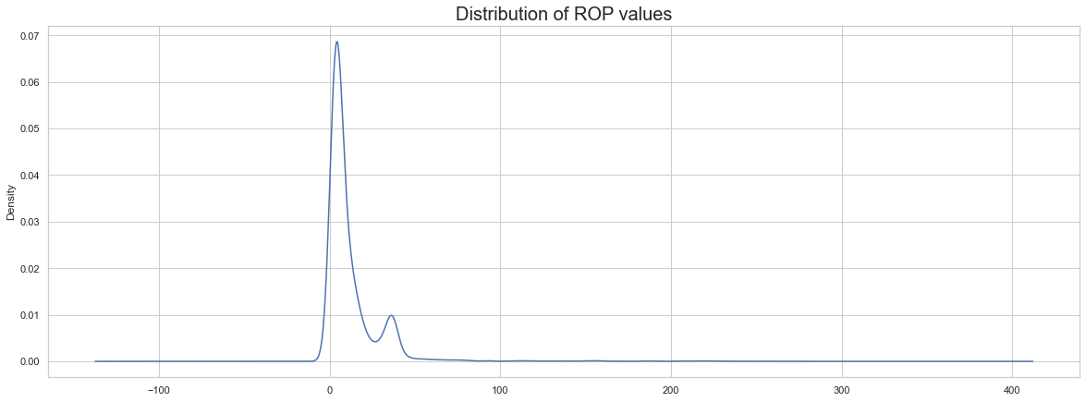
EDA WITH DATA VISUALIZATION

Slide 8
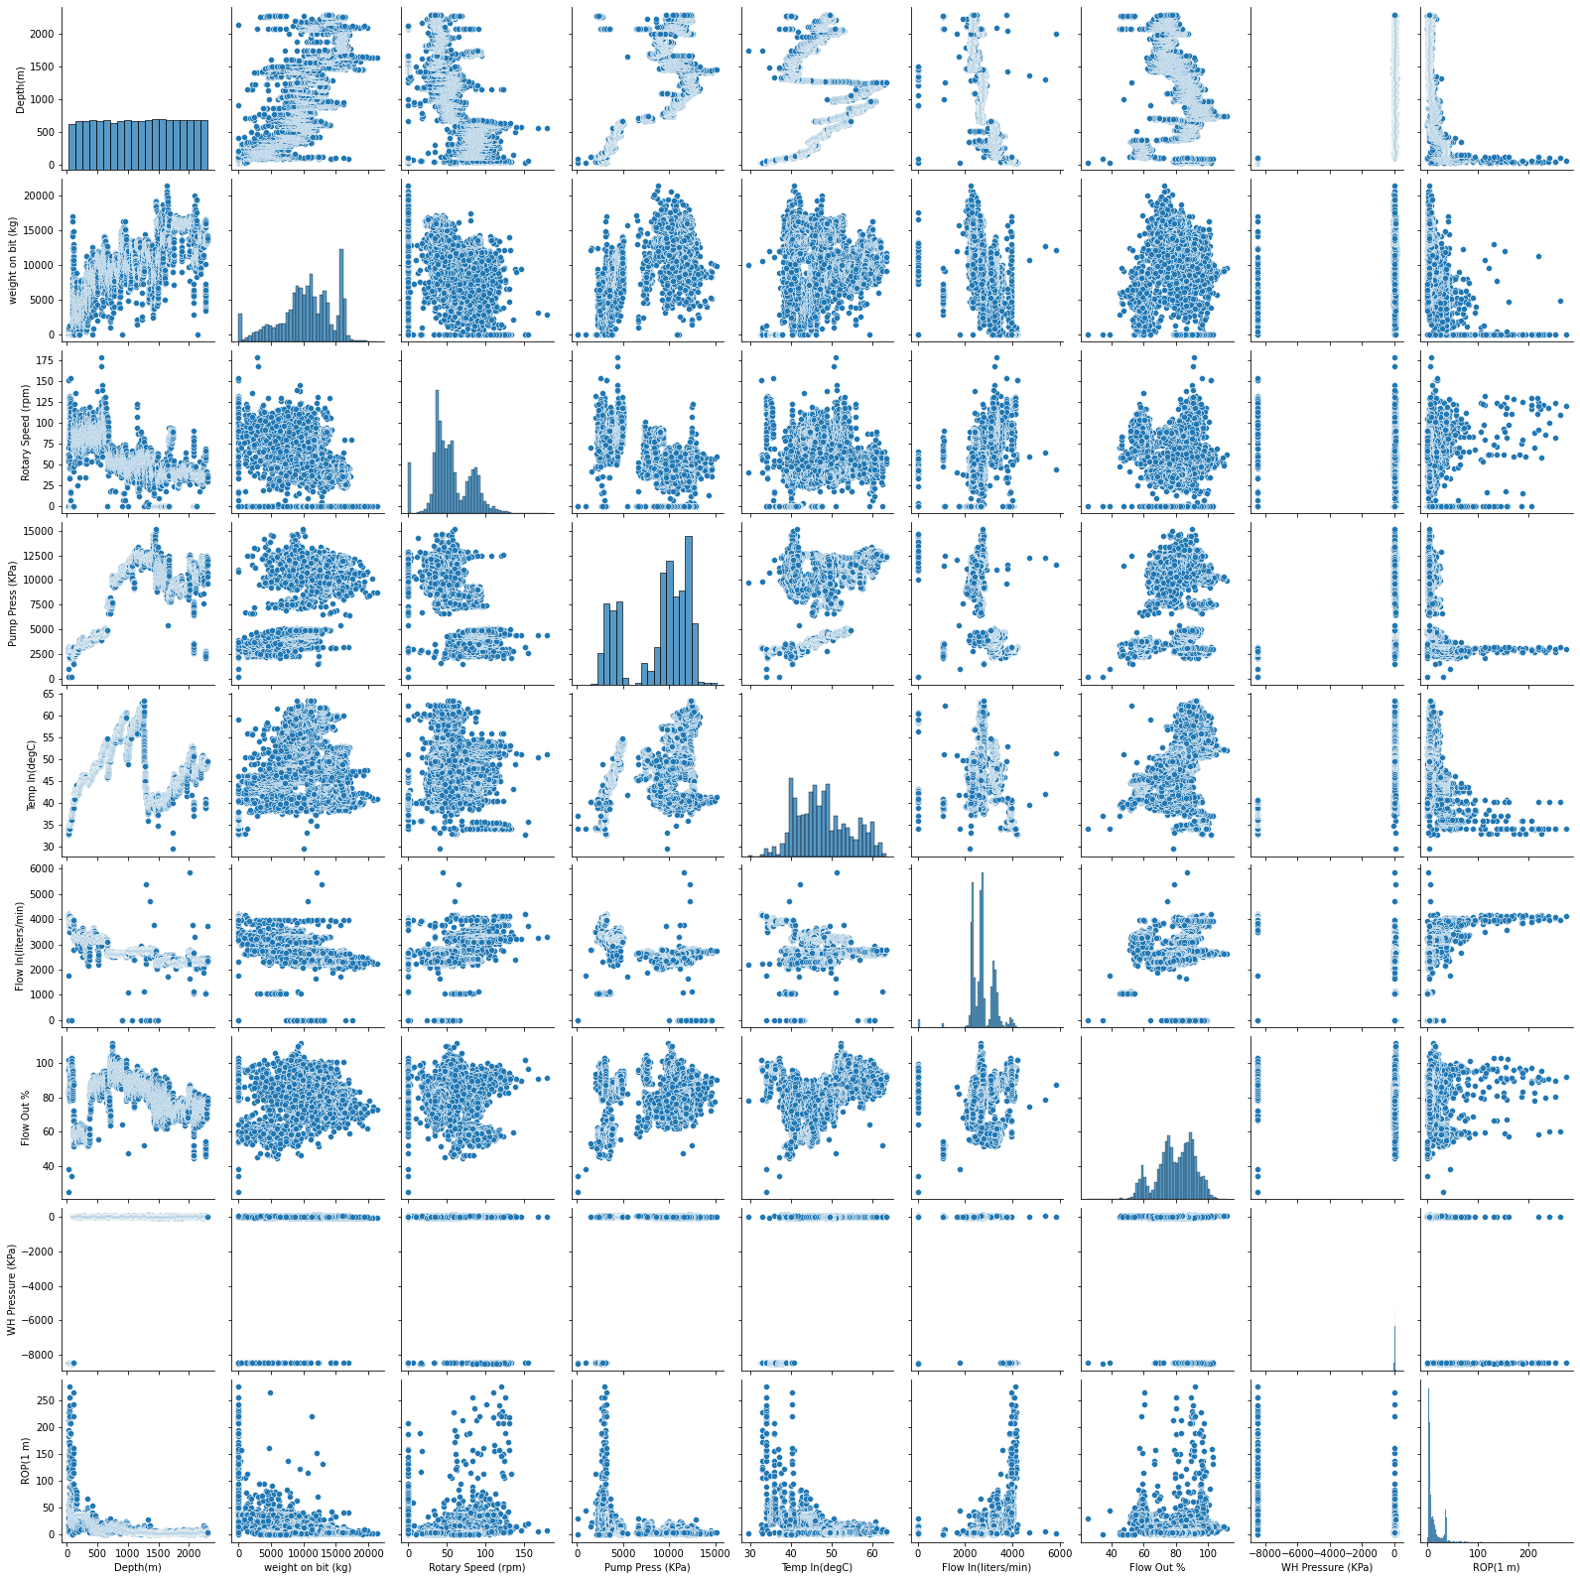
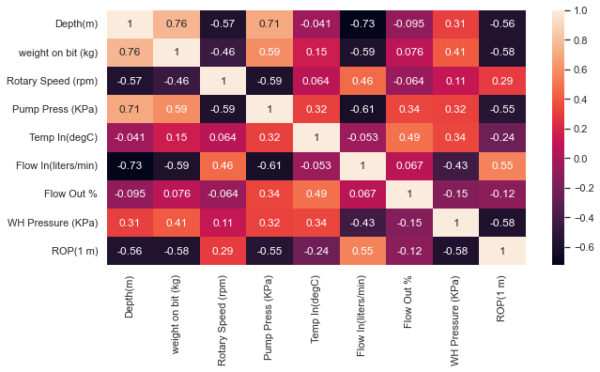
EDA WITH DATA VISUALIZATION
Depth, Weight on bit, Well head Pressure and Flow in are the four most independent Features. The pairplot shows the relationship between Features and the different ROP values.

Slide 9
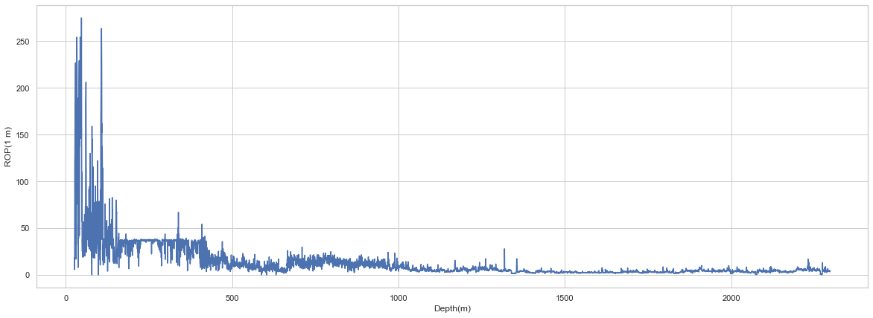
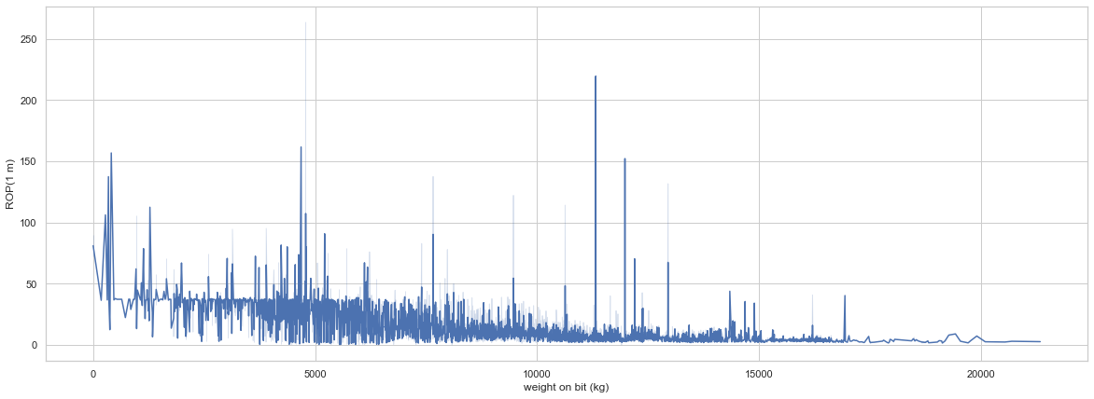
EDA WITH DATA VISUALIZATION
1.
1. Variation of Depth with Rate of Penetration.
2.
2. Variation of Bit weight with Rate of Penetration.

Slide 10
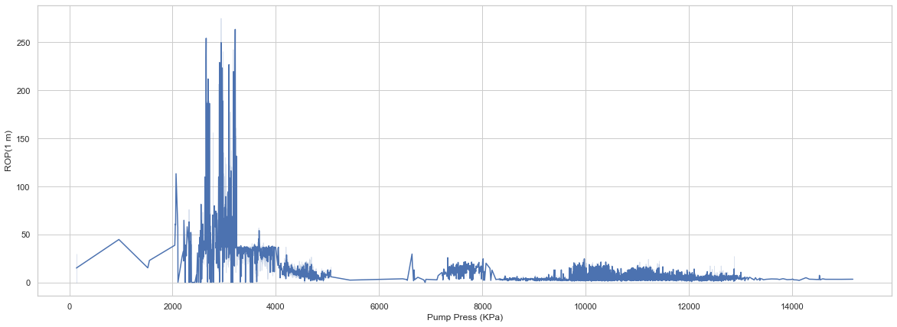
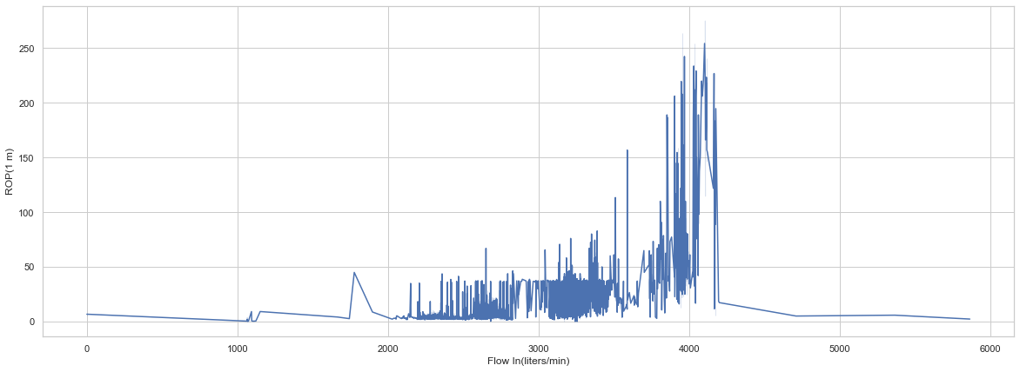
EDA WITH DATA VISUALIZATION
3.
3. Variation of Pump Pressure with Rate of Penetration.
4. Variation of flow in with Rate of Penetration.
4.

Slide 11
MODEL DEVELOPMENT WORKFLOW
Develop SVM/RF/XGBoost model and Neural network Architechure
Model development
Develop the model to fit chosen architecture
Define Losses and Metrics
Train model on data
Hyperparameter tuning
Model Evaluation
Tune parameters to get the best parameters for optimum performance of our chosen model.
Evaluate Model on R2 score, mean squared error(MSE), and coefficient of determination(R)

Slide 12
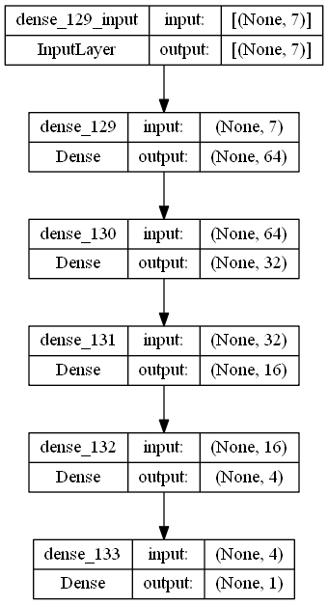
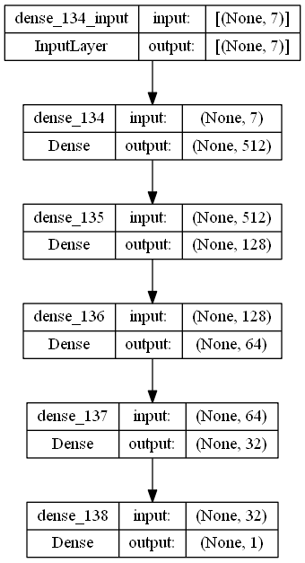
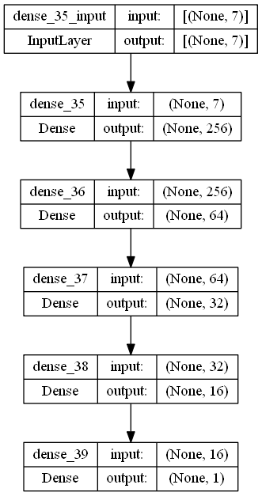
ANN – MODEL ARCHITECHURE AND DEVELOPMENT
Model 1
Model 2
Model 3

Slide 13
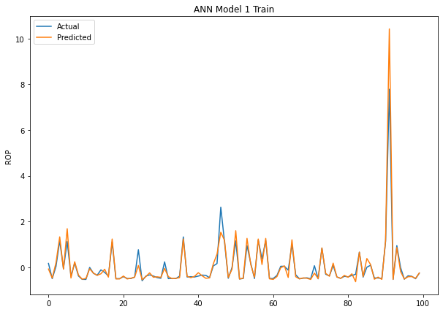
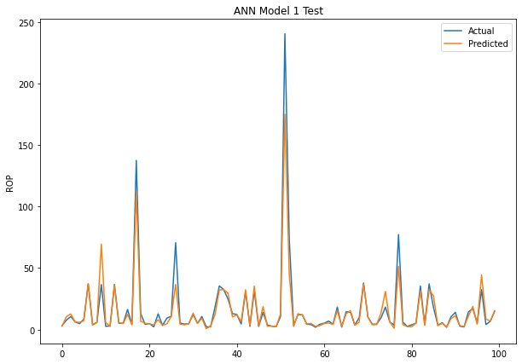
MODEL 1 – ACTUAL vs PREDICTED
TRAIN SET
TEST SET

Slide 14
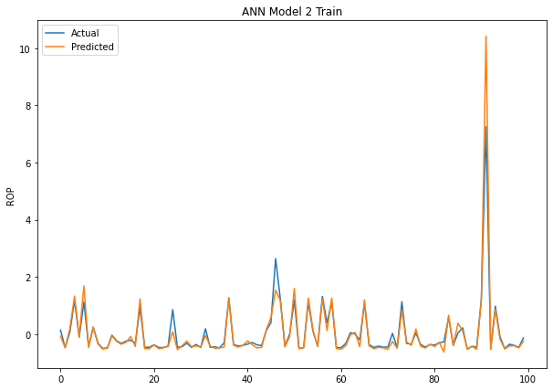
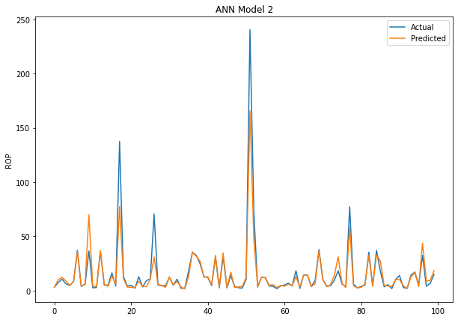
MODEL 2 – ACTUAL vs PREDICTED
TRAIN SET
TEST SET

Slide 15
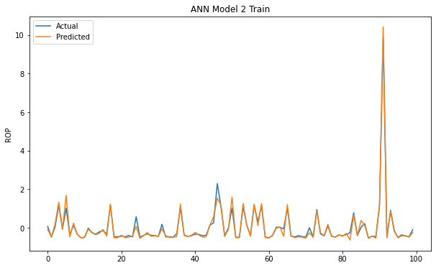
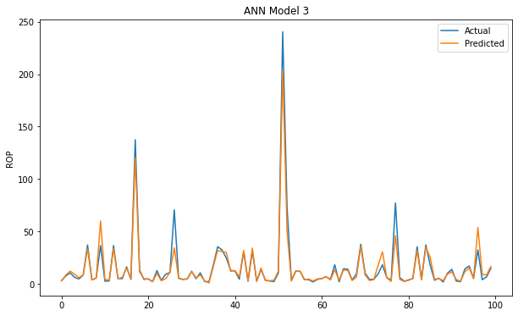
MODEL 3 – ACTUAL vs PREDICTED
TRAIN SET
TEST SET

Slide 16
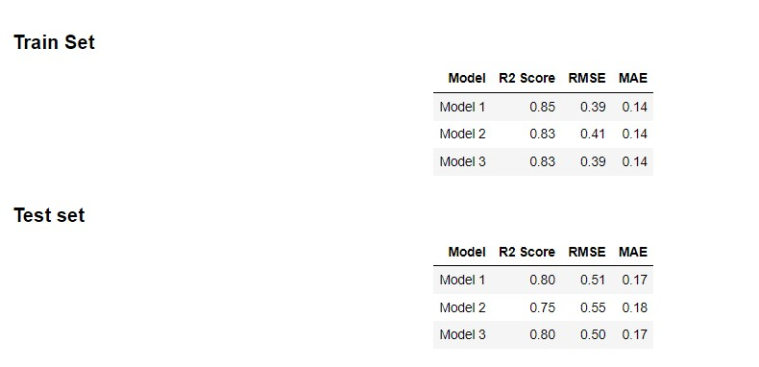
ANN MODEL EVALUATION SUMMARY
Three models were developed using artificial neural network. Model 3 did better in predicting the drilling rate of penetration with a test R2 score and RMSE of 0.80 and 0.50 respectively.

Slide 17
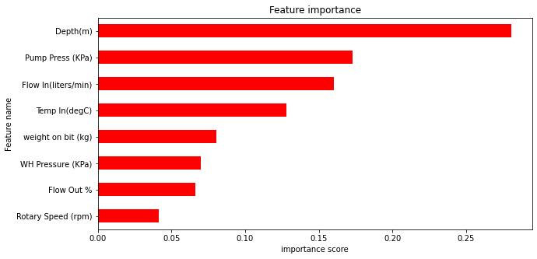
SUPPORT VECTOR MACHINES, RANDOM FOREST & XGBOOST
The Bar Chart below shows the importance of the various features in the model development in order. The top 3 features includes the Depth of the given well, the Pump pressure and the rate of flow.

Slide 18
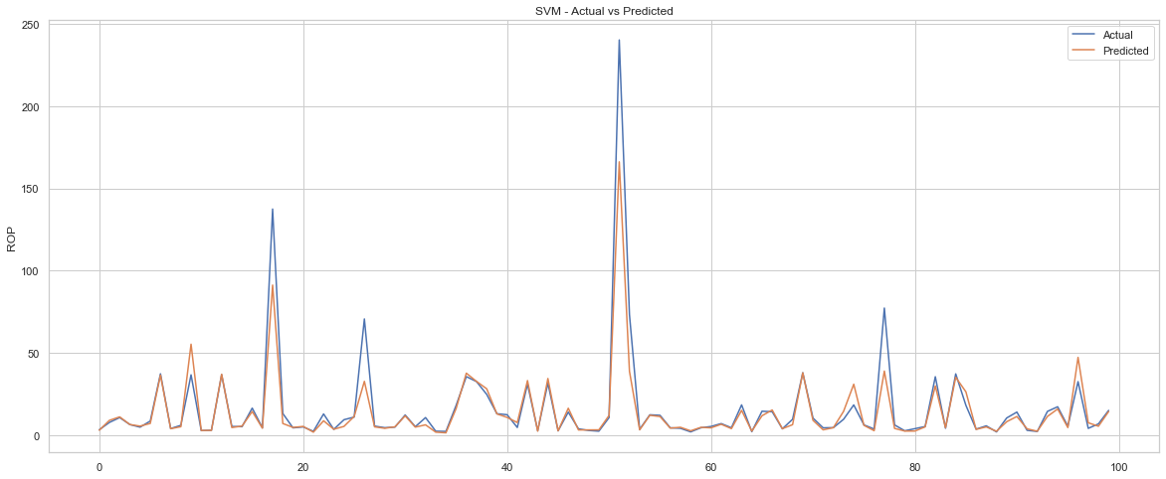
SVM – ACTUAL vs PREDICTED

Slide 19
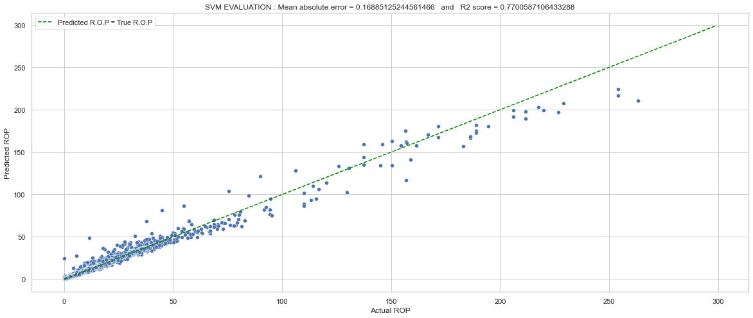
SVM – Correlation b/w actual and predicted
R = 0.87

Slide 20
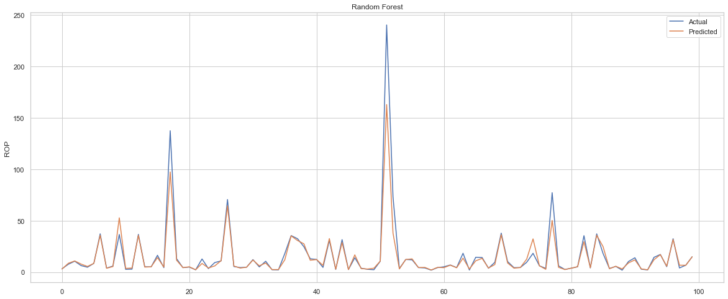
RF – ACTUAL vs PREDICTED

Slide 21
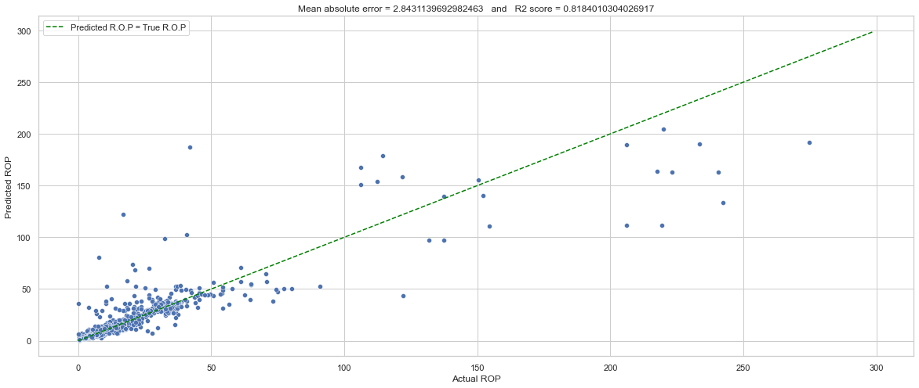
RF – Correlation b/w actual and predicted
R = 0.90

Slide 22
XGBoost – ACTUAL vs PREDICTED

Slide 23

XGBoost – Correlation b/w actual and predicted
R = 0.91

Slide 24
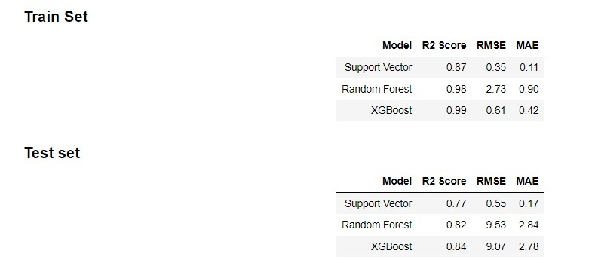
SVM/RF/XGBoost – EVALUATION SUMMARY
Extreme Gradient Boosting(XGBoost) Machine Performed better in predicting the drilling rate of penetration with a R2 score of 0.84.

Slide 25
CONCLUSION
Using a deep neural network based on the multilayer perceptron, the drilling rate of penetration were predicted, with R2 score up to 0.80.
Across all models developed, XGBoost performed better in R2 score of 0.84, although considering other stated metrics, the deep neural models were shown to performed better, however.
The deep neural models took far lesser time to train(fit) when compared to the distance and tree based models.
Optimizing the ROP is a key aspect to reduce total well cost,hence it is imperative that the optimal model is utilized.
I consider this work a continuous work in project as it’d be constantly updated should I be able to come up with better and more effective models.

Slide 26
LIMITATIONS
The data contained a large number of outliers across its features and sufficient information regarding the accepted industry range of values could not be ascertained and as such the outliers were removed following statistical guidelines.
Support vector machine requires significantly high computational time to fit the data despite just tuning a minimal number of hyper parameters.
The ideal hyper parameters for a specific model could not be ascertained as the tuned hyper parameters were chosen intuitively.

Slide 27
REFERENCES
https://link.springer.com/article/10.1007/s13202-0210-01394-w
https://www.sciencedirect.com/science/article/pii/S2090447920301350
https://www.researchgate.net/publication/286600958_Real-time_prediction_of_rate_of_penetration_during_drilling_operation_in_oil_and_gas_wells
https://github.com/Arbi-ben-aoun/Drilling-rate-of-penetration-prediction

